Slide 1
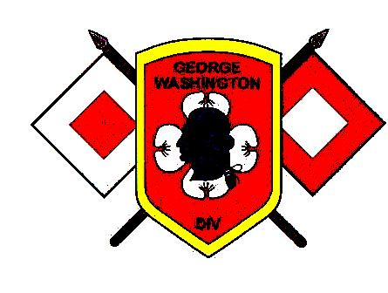
High Frequency Radio Team
(HFRT)
Skill Level 1
Place M700/710 Radio into Service

Slide 2
Purpose: The following slides gives basic instruction in the following
Skill Level 1 High Frequency Radio Team (HFRT) tasks as identified in
The HFRT Training and Evaluation Outline (T&EO):
Place ICOM M700/710 Pro Radio into Service
Conditions: You are located in the desired position and with
the necessary equipment to commence HF radio communications.
You have been given the CEOI required for your mission.
Standard: The team after, completing the block of instruction, safely
set up the radio and transmit a message using correct radio
procedures within 60 minutes.

Slide 3
Safety Briefing:
Never erect antennas less than 2 times its length close to energized power lines.
Never touch or be in close proximity to antennas when transmitting or burns could result.
Always ground equipment using proper grounding techniques.
Note: The VDF has equipped its HFRT units with two types of ICOM radios, M700 and M710 Pro Marine radios. They are interchangeable for the purposes of these tasks/lessons.

Slide 4
Siting Considerations:
When siting the radio consider the following:
Length of coax and tuner cables.
Shelter from elements, if outside
Routing of cables if inside.
Availability of commercial electricity (shore power).
Availability of tables, chairs, etc.
Location of mission commander. (quiet place for radio so you can hear it, but also able to find the mission commander when delivering messages.

Slide 5
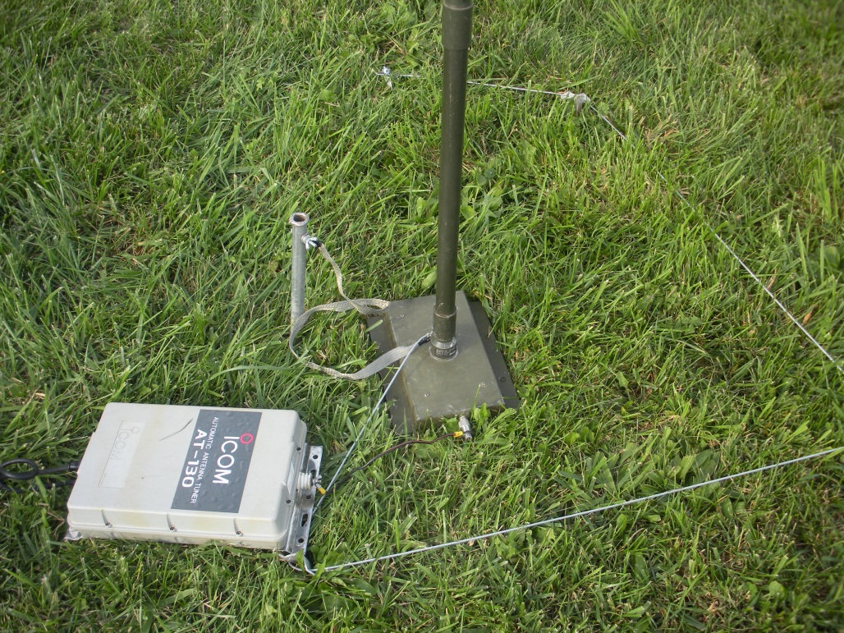
Step 1
Place tuner at base of antenna.
Attach lead from grounding stake
to tuner.

Slide 6
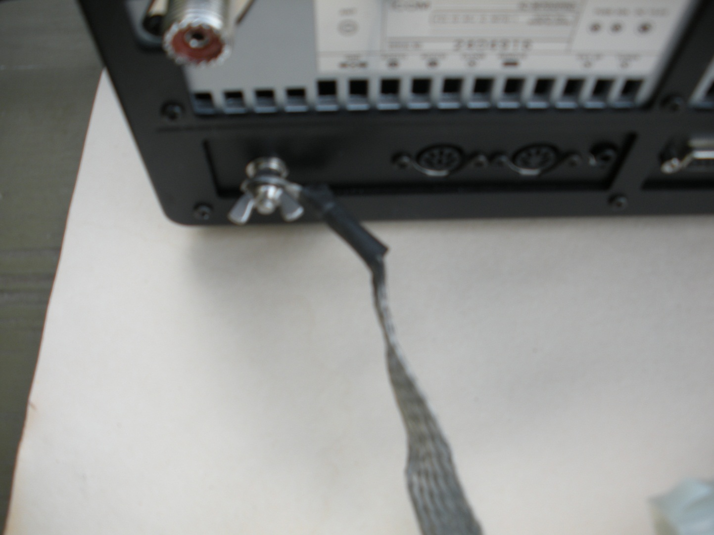
Step 2
Run ground lead from a grounding stake to back of radio.

Slide 7
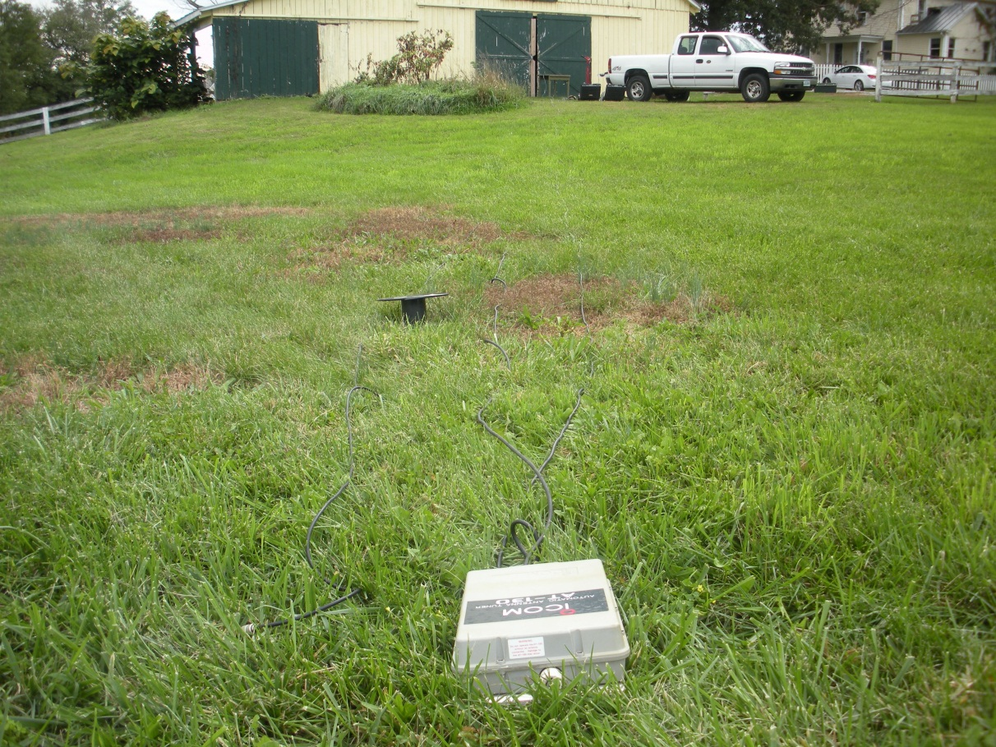
Step 3
Run tuner and coax cables to radio.

Slide 8
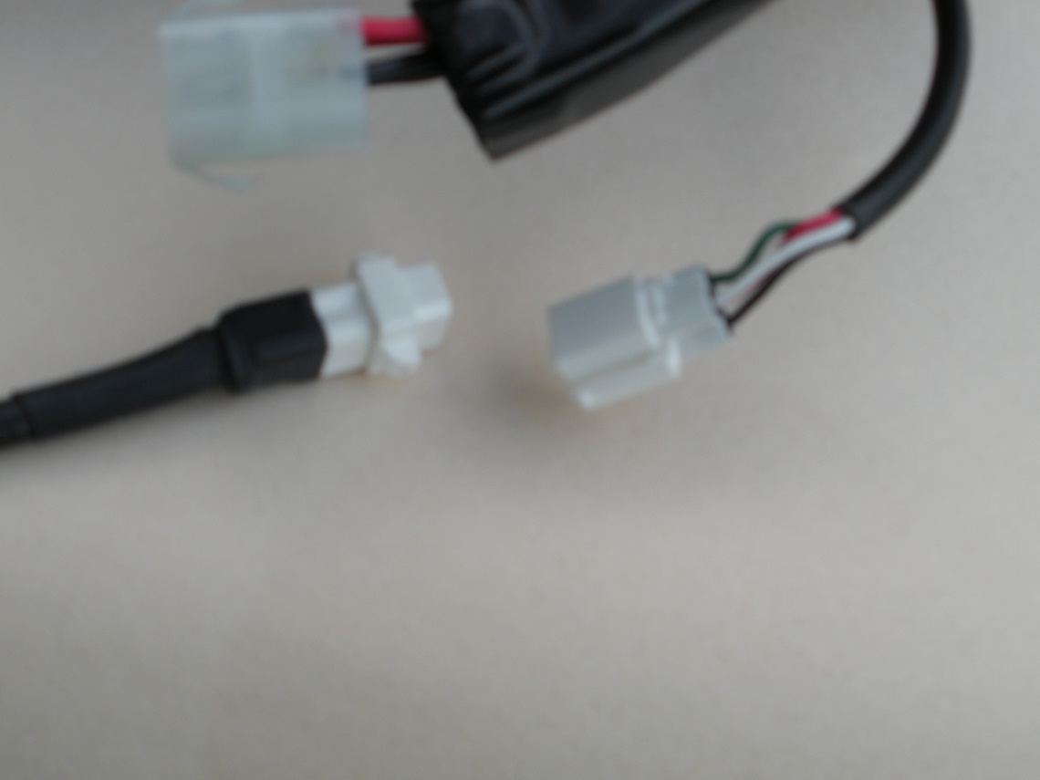
Step 4
Connect Tuner cable
to radio

Slide 9
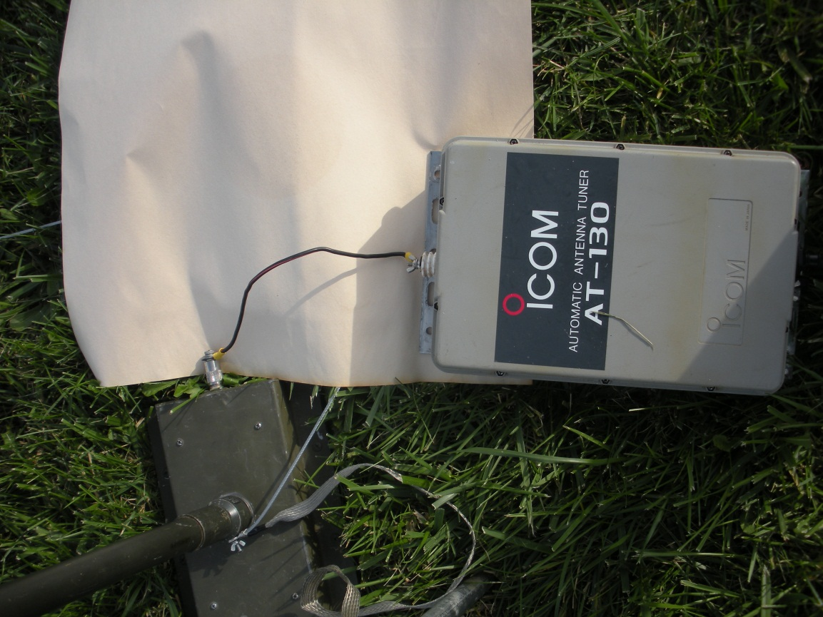
Step 5
Connect “hot” wire from tuner to antenna base.
Connect tuner ground terminal to the antenna ground via a
grounding wire.

Slide 10
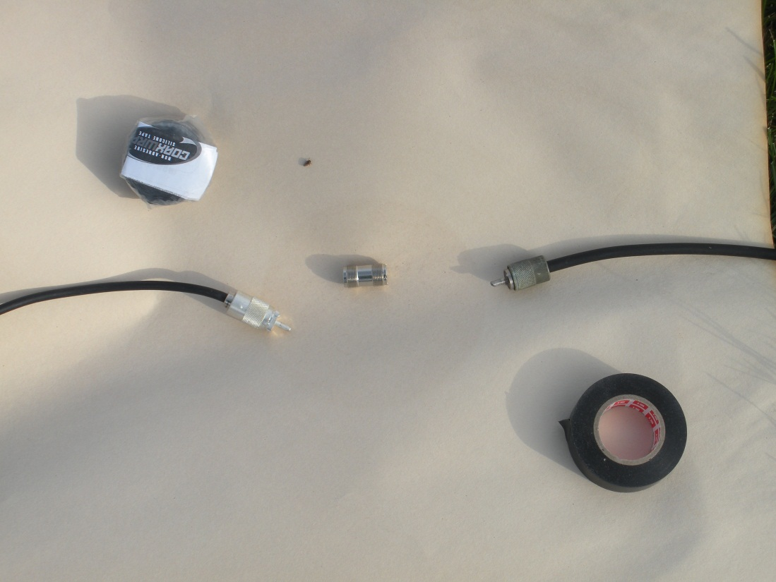
Step 6
Connect tuner coax to antenna
coax with a barrel connector. If
you are going to be active during
rainy weather, wrap tape around
the barrel connector to waterproof it. A non adhesive tape sold by “ham” stores is
best for this application. However, if the special tape is not available, use regular electricians
“friction” tape.

Slide 11
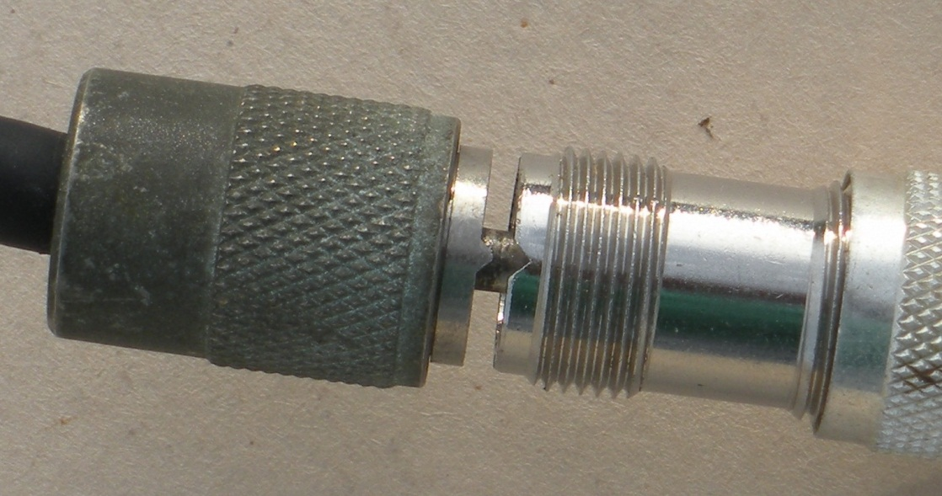
When connecting the PL-259 type of connectors, make sure the projection
is inserted in the connector before turning the shell. This prevents the
connector from turning and possibly breaking the wires.

Slide 12
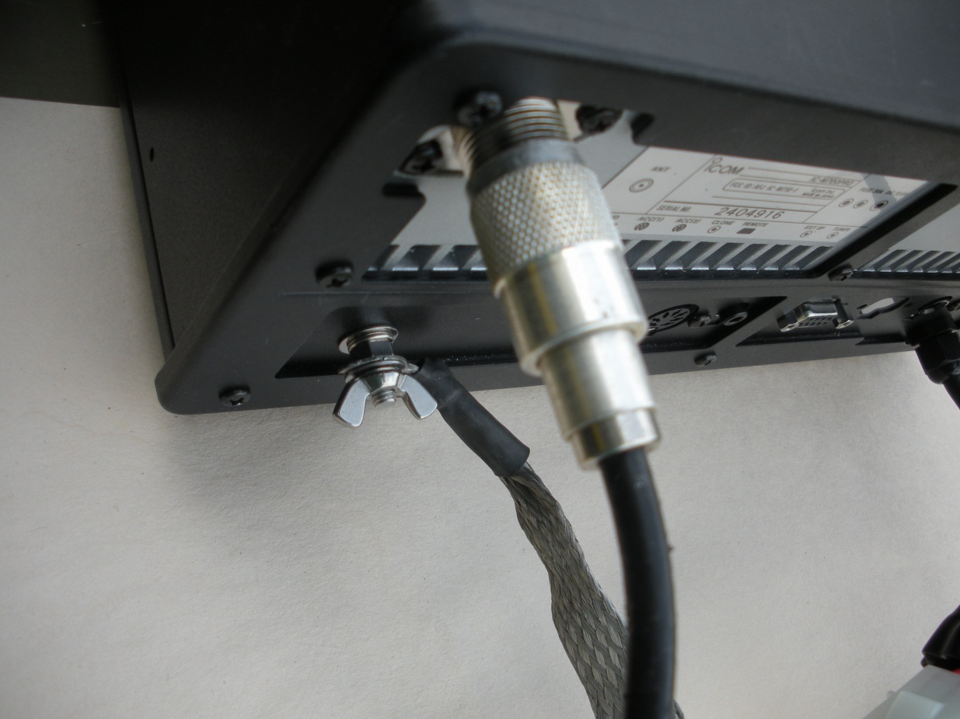
Step 7
Connect the antenna coax to the radio connector.

Slide 13
Step 8
Connect your power source to the radio connector
Commercial (shore) Power- The radio is issued with a power supply which uses house current to produce the 12v required by the radio. To use, simply hook up the appropriate ring terminals to the power supply. Remember to pay close attention to the polarity. Black wire goes to negative connection and red wire goes to positive connection.
Battery- You can also use any 12v battery to power the radio. Car or motorcycle batteries may be used. A motorcycle battery will have less available power than a car battery. As above, pay close attention to polarity.

Slide 14
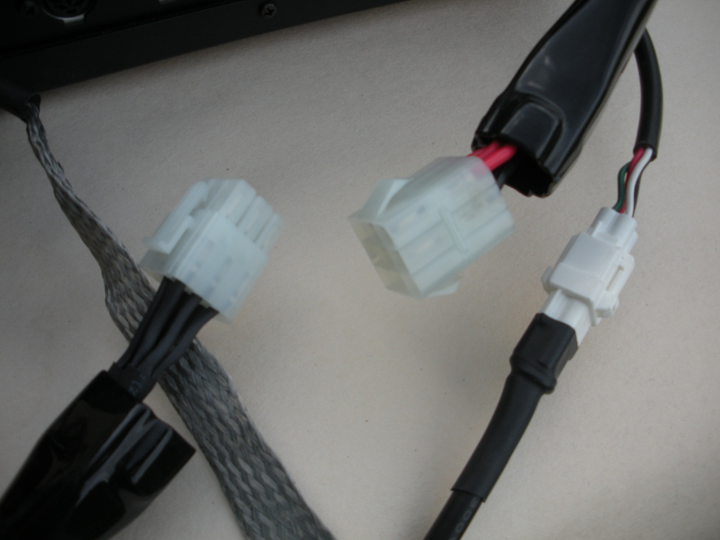
Step 9
Connect the power connector at the back of the radio. The connector will go together only one way. Insert the connector halves together until they “snap” together..

Slide 15
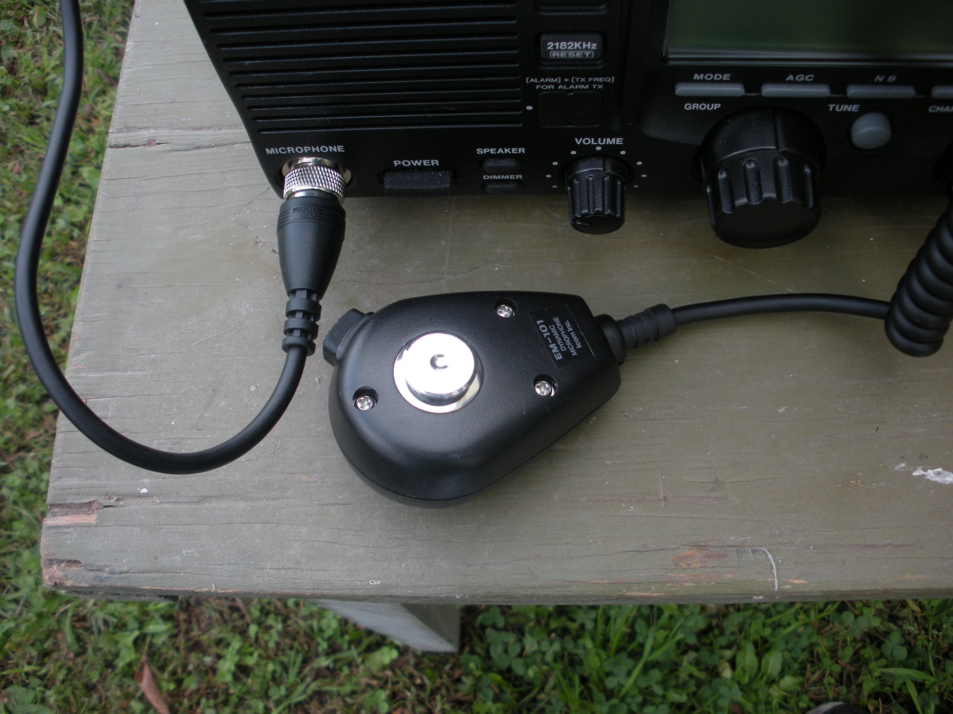
Step 10
Connect the microphone
to the front of the radio.
Make sure that the micro-
phone plug is inserted
properly into the jack. Don’t force the connector. Tighten the sleeve.

Slide 16
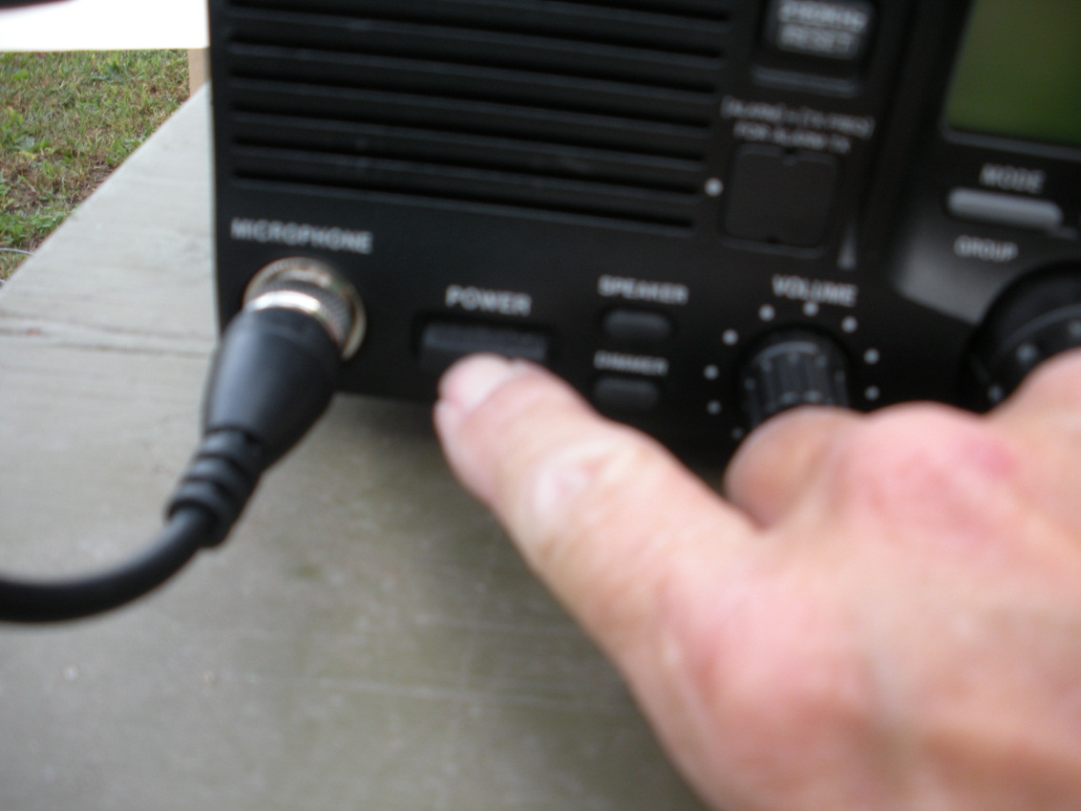
Step 11
Double check all connections and
then power up the set.

Slide 17
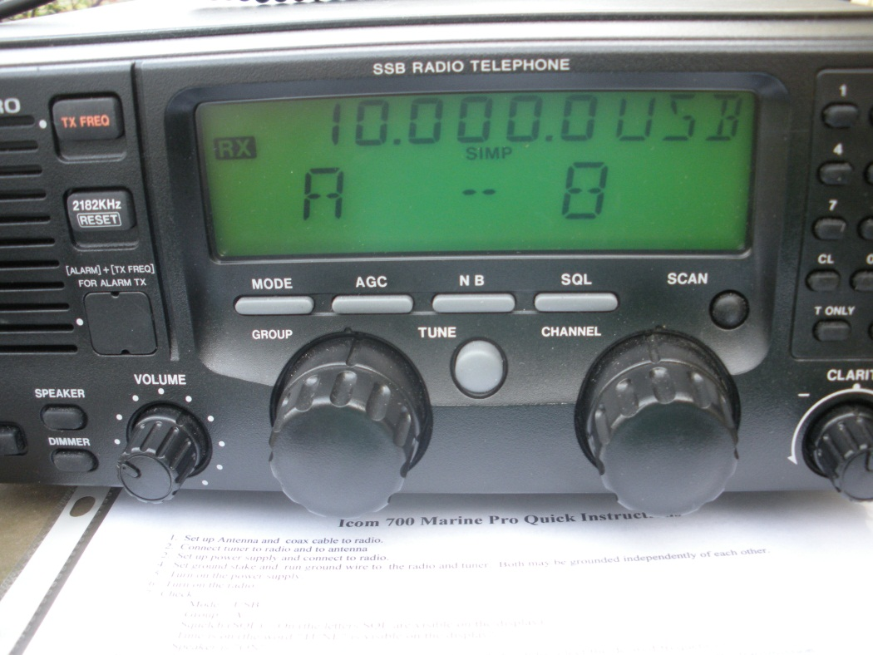
Step 12
Consult the CEOI or the OPORD
to determine the operating frequency.
Set frequency by turning the channel
knob to the required frequency.
Check the initial settings:
Mode = USB
Group = A
Squelch(SQL) = ON
Tune is on (TUNE is visible)
Speaker is “ON”
Radio is now ready for use.

Slide 18
Troubleshooting

Slide 19
A note about fuses. If the radio doesn’t power up, check the fuses. There are
three fuses used in this set. Two accessible on the back of the set and one
which you have to remove the cover to access.
Troubleshooting

Slide 20
Tips To Secure Radio
Break down the radio in the reverse of assembling it.
Coil all cables neatly and secure with tape or string.
If you are issued cases, pack the items neatly into the cases.
Double check the hand receipt to make sure you don’t leave anything behind.
Report any problems on the DA Form 2404 so they can be fixed before re-issue.

Slide 21
Operation Tips
If having difficulty in hearing, turn off squelch.
Check radio systems by tuning to WWV (national time center) at 2.500, 5.000, 10,000 Mhz.
Do not change any programming without authorization.
The frequency will change according to time of day. Be prepared to change freqs as the conditions change.
Ask for help as soon as you identify a problem to prevent a small problem becoming a big one!
Use your T&EO to assist you in completing your mission.

Slide 22
Task: Place the ICOM M700/710 Pro Radio Into Service
Questions?????

